Slide 1
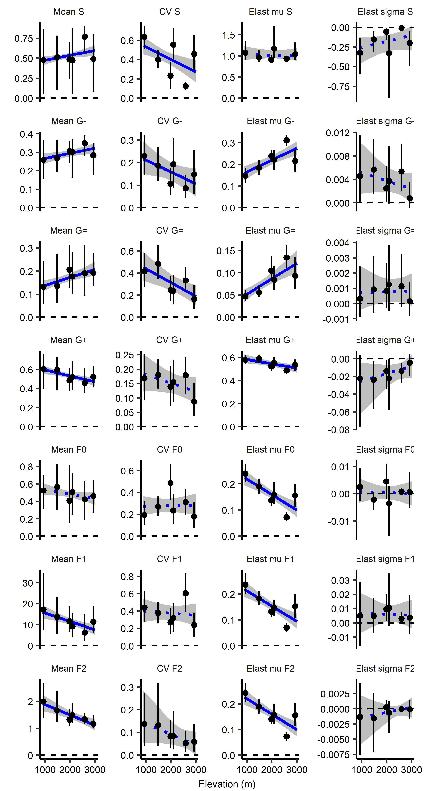
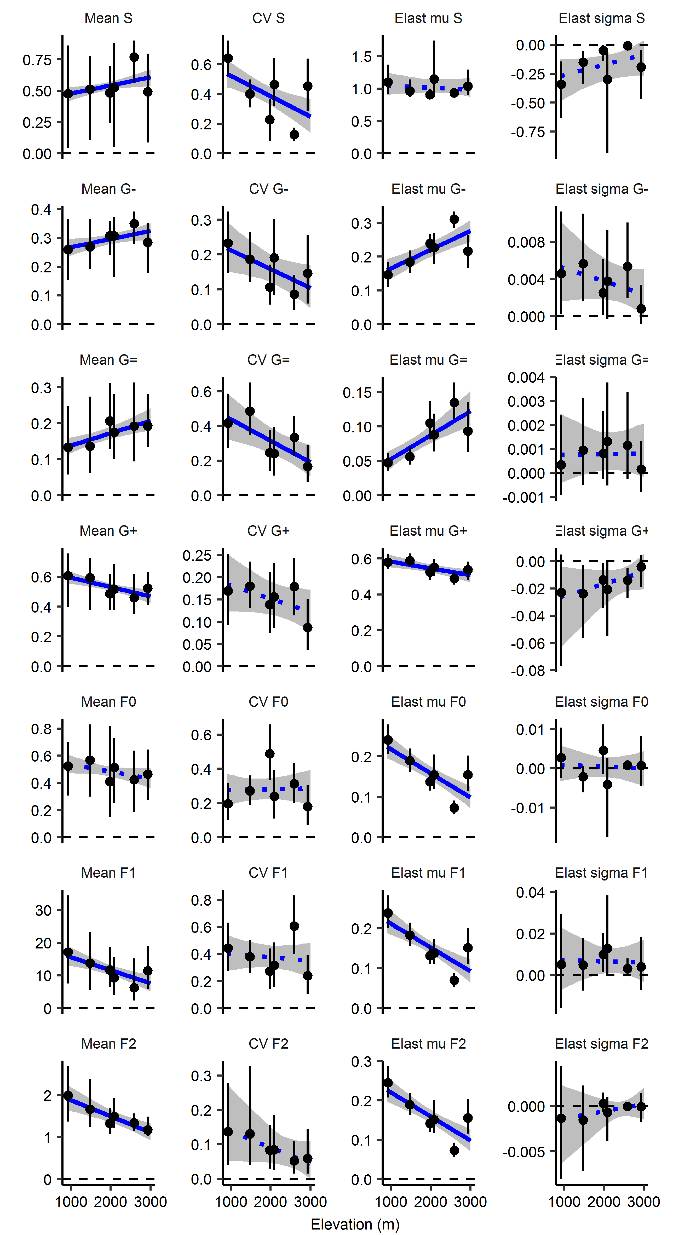
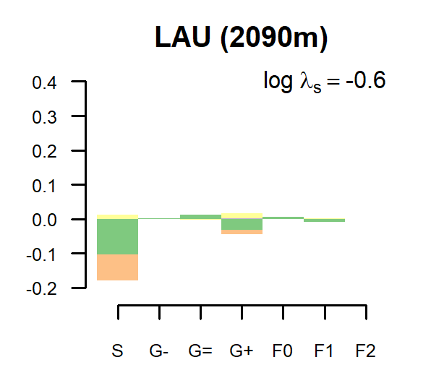
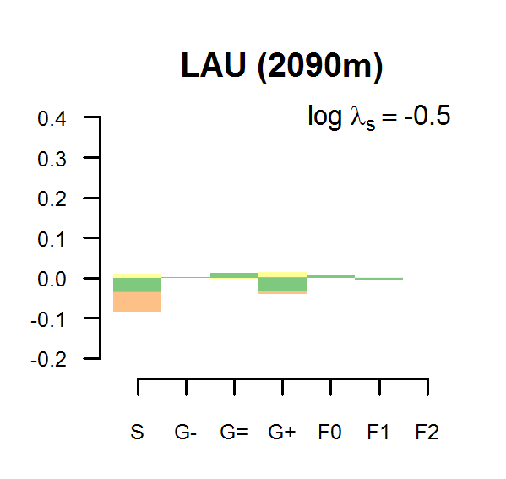
Including 2009 Excluding 2009 (baseline)
Including 2009 Excluding 2009 (baseline)

Slide 2
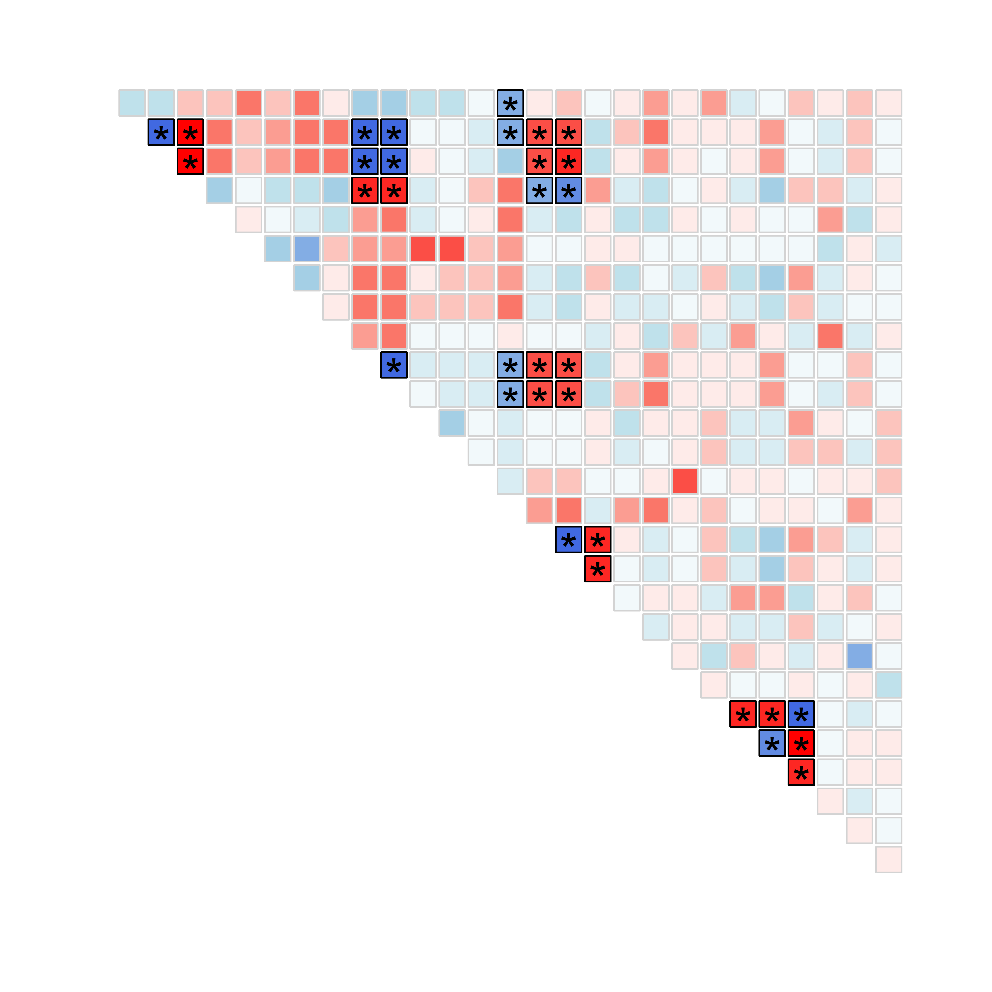
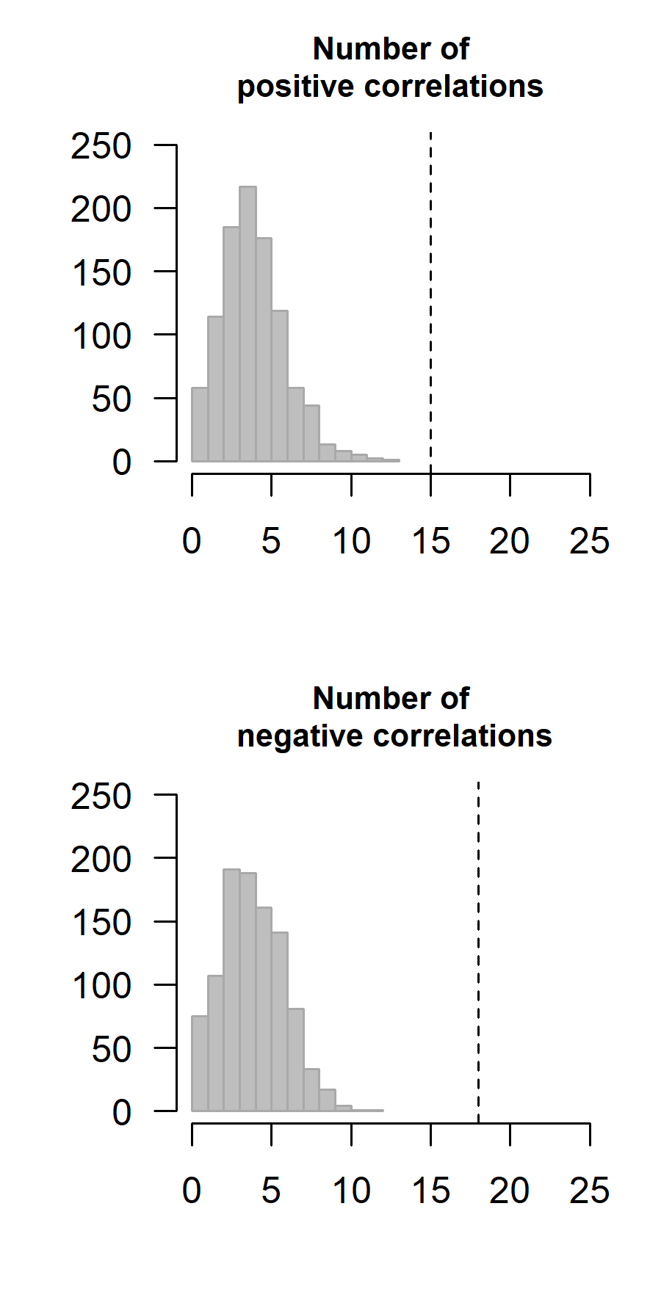
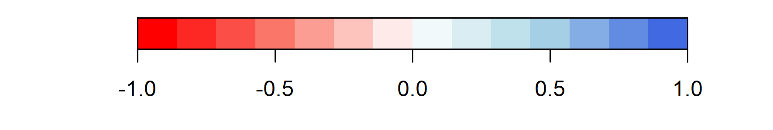
Means Elasticities Temporal variability Temporal correlations
G⁻ G⁼ G⁺ F₀ F₁ F₂ S G⁻ G⁼ G⁺ F₀ F₁ F₂ S G⁻ G⁼ G⁺ F₀ F₁ F₂ S G⁻ G⁼ G⁺ F₀ F₁ F₂
Including 2009
S
G⁻
G⁼
G⁺
F₀
F₁
F₂
S
G⁻
G⁼
G⁺
F₀
F₁
F₂
S
G⁻
G⁼
G⁺
F₀
F₁
F₂
Means Elasticities Temporal variability Temporal correlations
S
G⁻
G⁼
G⁺
F₀
F₁
Spearman’s correlation coefficient

Slide 3
